Slide 1

DriverPass System Analysis
Michael Watkins
Notes:
[No speaker notes required for this slide.]

Slide 2

System Requirements
Functional Requirements
Reservation management
Lesson Status Tracking
Nonfunctional Requirements
Scalability
Security
Notes:
Reservation Management This feature is essential for customer interaction. It must be user-friendly and provide real-time updates on lesson availability.
Lesson Status Tracking
This functionality ensures the system remains up-to-date, reflecting the actual status of driving lessons, which is crucial for both management and customers.
Scalability Scalability is key for future growth. The system should adapt to increased load without compromising user experience.
Security Security is paramount, given the sensitive nature of the data. The system must incorporate robust encryption and access controls.

Slide 3
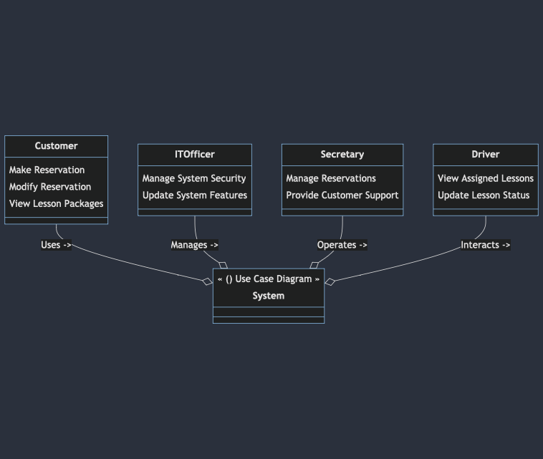
Use Case Diagram
[Insert your use case diagram here.]
Notes:
This diagram includes classes for each actor (Customer, IT Officer, Secretary, Driver) and their respective use cases. The System class acts as a focal point, showing the interaction between the actors and the system. Each class represents a user role and their potential actions within the DriverPass system.

Slide 4
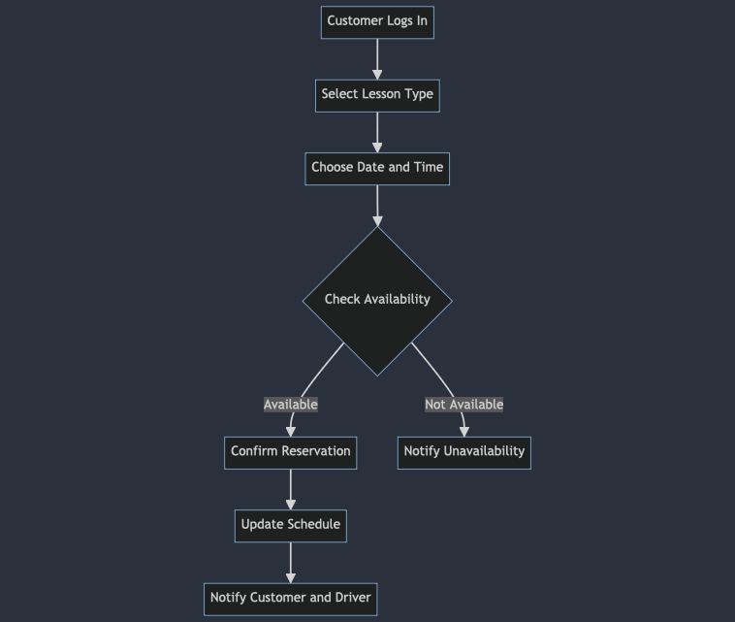
Activity Diagram
[Insert one of your activity diagrams here.]
Notes:
Customer Logs In (A): The customer starts by logging into the system.
Select Lesson Type (B): The customer then selects the type of driving lesson they want.
Choose Date and Time (C): Next, they choose their preferred date and time for the lesson.
Check Availability (D): The system checks if the selected time slot is available.
Branching:
If available (D -- Available), it proceeds to Confirm Reservation (E), where the system confirms the booking.
If not available (D -- Not Available), it leads to Notify Unavailability (F), where the customer is informed about the unavailability.
Update Schedule (G): Once confirmed, the system updates the lesson schedule.
Notify Customer and Driver (H): Finally, both the customer and the assigned driver are notified of the reservation.

Slide 5
Security
User Authentication: Secure login process to ensure only authorized users access the system.
Data Encryption: Protection of sensitive data, like personal and payment information, during transmission and storage.
Access Control: Restricting system access based on user roles (e.g., customer, driver, admin) to prevent unauthorized data access.
Regular Security Audits: Periodic checks to identify and fix any potential security vulnerabilities.
Activity Monitoring: Tracking user activities within the system to detect and respond to suspicious actions quickly.
Notes:
In designing the DriverPass system, security was a top priority. We made sure that personal information, like names and payment details, is well protected. Think of it like putting your valuables in a safe; we used similar measures to keep your data secure. This means only authorized people can access important information, and it's kept safe from anyone who shouldn't see it. We also ensured that our system can detect and prevent any unusual activities, much like a good security system in a house.

Slide 6
System Limitations
Dependence on Internet: Requires a stable internet connection for optimal functionality.
Limited Customization: The system may not cater to all specific user needs or preferences.
Technological Familiarity Required: Users less comfortable with digital platforms may find it challenging to navigate.
Scalability Constraints: Initially designed for a certain size, might need updates to handle significant growth.
Maintenance and Updates: Requires regular updates and maintenance to keep the system running smoothly.
Notes:
The design of the DriverPass system, while robust, has a few limitations. First, it relies heavily on internet connectivity.
So, if you're in an area with poor internet, you might find it tricky to book lessons or update information
Secondly, our system is designed with certain features that might not cover every unique customer need or preference. Lastly, because it's a digital system, users who are less comfortable with technology might need some extra time to get used to it.

